Slide 1
病理图像分析的概念
the concept of histopathology image analysis
综述论文的结构
the structure of the paper
病理图像分析的主要方法
the main methods of histopathology image analysis
病理图像分析的数据库和源码
the data and code of histopathology image analysis

Slide 2
病理图像分析概念
1
Part One

Slide 3
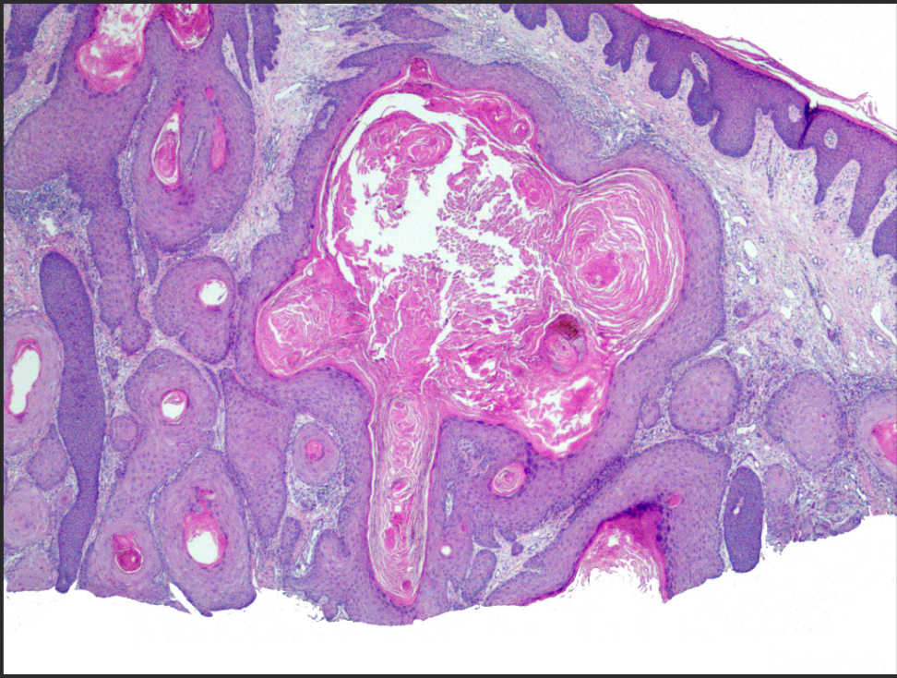
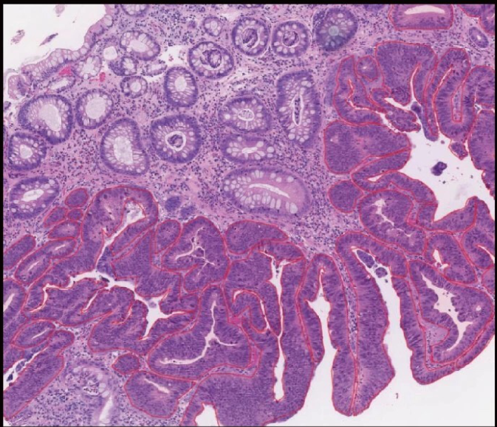
The concept of histopathology image analysis
Histopathological image analysis adopts advanced image processing technology and high-precision hardware configuration, and realizes color and automation from the acquisition, measurement and processing of system signals to printout.
configuration
realizes color

Slide 4
综述论文结构
2
Part Two

Slide 5
The structure of the paper
一、Foreword
二、Main body
Briefly describe the purpose of this paper, the problems to be solved, and clearly explain the basic content and scope of the topic.
it can list subheadings and form several small parts,it focuses on the historical changes, current situation analysis and trend prediction of the topic.
三、Summary
四、References
On the basis of briefly summarizing the main contents of the main part, the author puts forward his personal views
At the end of the article, it reflects the author's respect for the original author and shows that the cited literature is well-founded and provides readers with clues about the literature.

Slide 6
病理图像分析的主要方法
3
Part Three

Slide 7





The main methods of histopathology image analysis
01
02
Determining the central position of the nucleus in the pathological image，based on this, the structural features of the nuclear distribution are extracted.
One or more of the structural features of the graph are calculated to obtain the global features of the nucleus.
9
03
04
main methods
Local features are extracted near the location of the nucleus, and fused with global features to obtain fused features.
classufued the fused features

Slide 8
源码
4
Part Four

Slide 9

互联网医疗发展现状
https://www.webofscience.com/wos/alldb/full-record/WOS:000783829500011
https://www.webofscience.com/wos/alldb/full-record/WOS:000819832600035
https://www.webofscience.com/wos/alldb/full-record/WOS:000578080300041

